Slide 1

LinkedIn Post Generator
Generate engaging LinkedIn posts in your preferred influencer's style.
Presented By: Syed Amanat Ali Shah
This Photo by Unknown Author is licensed under CC BY

Slide 2

The Problem
Why This Project?
Writing consistent and engaging posts for LinkedIn is time-consuming.
Not everyone is skilled in copywriting or personal branding.
Many users admire successful influencers and want to emulate their tone.
Quote: "I want to write like that influencer — but I don’t know how."

Slide 3

The Solution
What My App Does:
Generates LinkedIn posts based on:
Topic (Tag)
Length (Short, Medium, Long)
Language (English, Hinglish)
Influencer Style (Writes like your selected influencer)
Result: Ready-to-use, human-like content tailored to your tone.

Slide 4

Target Audience
🧑 Job seekers
🧑‍💼 Content creators
📢 LinkedIn influencers
🧠 Career coaches
📈 Social media managers
Goal: Empower users to share content confidently and consistently.

Slide 5

How It Works (Flow)
User Input (Tag, Length, Language, Influencer)
Get Sample Posts from JSON
Few-shot Prompting
LLM (OpenAI/Groq)
Generated Post

Slide 6

The Dataset
Data Source
Curated posts from a real LinkedIn influencer
Data Fields
text – actual post content
engagement – number of likes/comments
line_count – length of postlanguage – English / Hinglish
tags – topics like “Job Search”, “Mental Health”
influencer – name (used for style matching)

Slide 7
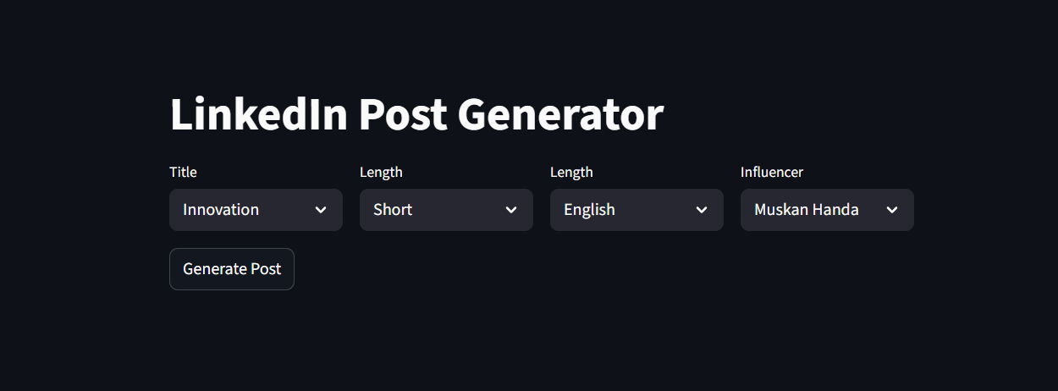
Features of the App
Select Topic, Length, Language
Choose from a list of known Influencers
Generates a human-like post using a few-shot prompt
Uses real-world influencer styles
Built using Streamlit + Python

Slide 8

Behind the Scenes – Tech Stack
Frontend:
Streamlit (for UI)
Backend:
Python (Pandas for data filtering)
Few-shot prompt generation
LLM API like OpenAI/Groq
Data
processed_posts.json

Slide 9
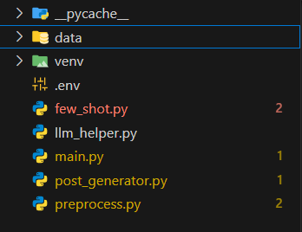
Code Structure
few_shot.py – (Data filtering, tag and influencer logic)
post_generator.py – (Prompt creation logic)
main.py – (Streamlit frontend)

Slide 10
Demo Output
Input:
Tag: Job Search
Length: Medium
Language: English
Influencer: Muskan Handa

Slide 11
Generated Output
Here's a LinkedIn post on the topic of Job Search:
When the job search feels like an uphill battle...
I know the feeling of sending out application after application, only to be met with crickets. 🐰
It's demotivating, to say the least. You start to wonder if you're good enough, if you're doing something wrong, and if you'll ever find the right fit. 🤔
But here's the thing: you're not alone. 🌈
According to a study, 75% of job seekers report feeling stressed or overwhelmed during their search. It's normal to feel frustrated, but don't let it define you.
Take a step back, recharge, and remember that your worth is not tied to a job title or salary. 🌟
You are more than your job search. Your skills, experience, and passion are valuable, regardless of whether you have a job or not.
Keep pushing forward, and don't give up on yourself. You got this! 💪

Slide 12

Challenges Faced
Ensuring JSON data was clean and tagged properly
Designing prompt to match influencer tone
Handling posts with mixed languages
UI logic for combining filters dynamically

Slide 13

Future Improvements
Add more influencers
Allow users to upload their own posts to “train style”
Add GPT-based tone sliders (formal, casual, funny)
Enable multi-language generation (Urdu, Tamil, etc.)
Save/download generated posts directly

Slide 14

Conclusion
Built a working AI writing assistant for LinkedIn
Helps users craft content in a familiar tone
Saves time, boosts engagement, and inspires consistency

Slide 15

Thank You
Thanks for your time! Let’s connect on LinkedIn! [www.linkedin.com/in/amanat-ali-765110264/] 📧 [syedamanatalishahkazmi@gmail.com] 🌐 [https://github.com/amanat838]

